Slide 1
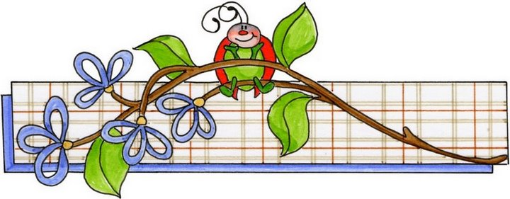
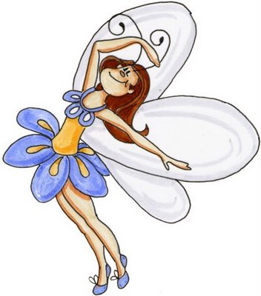
have-has
I have …
You have …
We have …
They have …
He has …
She has …
It has …

Slide 2
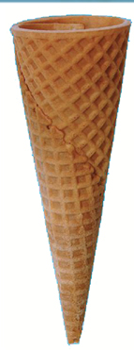
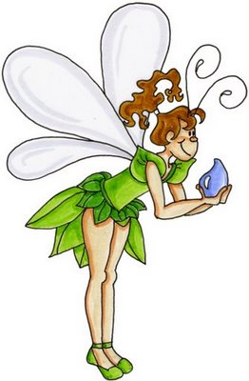
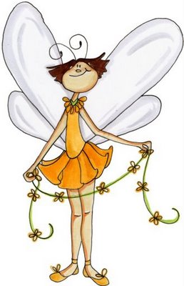
we
they
it
you
I
she
he
have
has

Slide 3
have or has
Write sentences in your notebook. Present your work in the class.
I … a good book.
You … a brown cat.
He … a big house.
She … a green car.
We … a pink bag.
The man …. three children.
They … yellow bananas.
My cat …. two blue eyes.
The house ….. three windows.
have
have
has
has
have
has
have
has
has

Slide 4
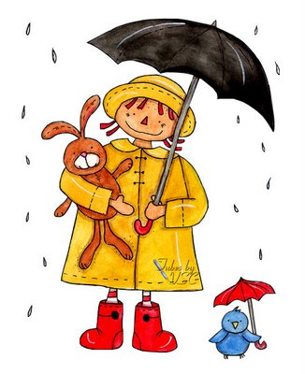
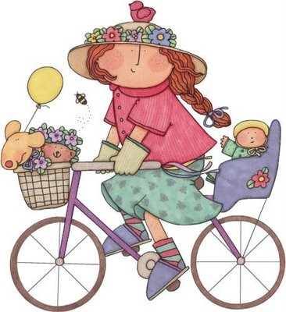
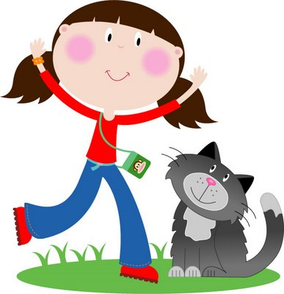
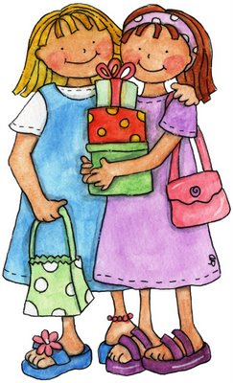
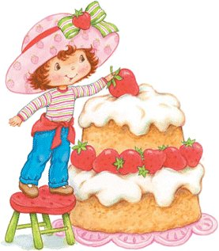
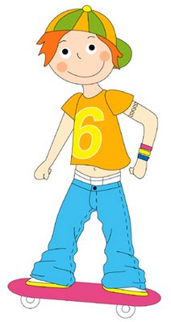
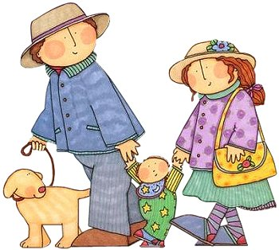
Write sentences in your notebook. Present your work in the class: What do they have?
cat, umbrella, cake, baby, bike, skateboard, presents
Jenny … …
Dana … …
Berta … …
The girls… …
She … …
They… …
Tom … …

