Slide 2
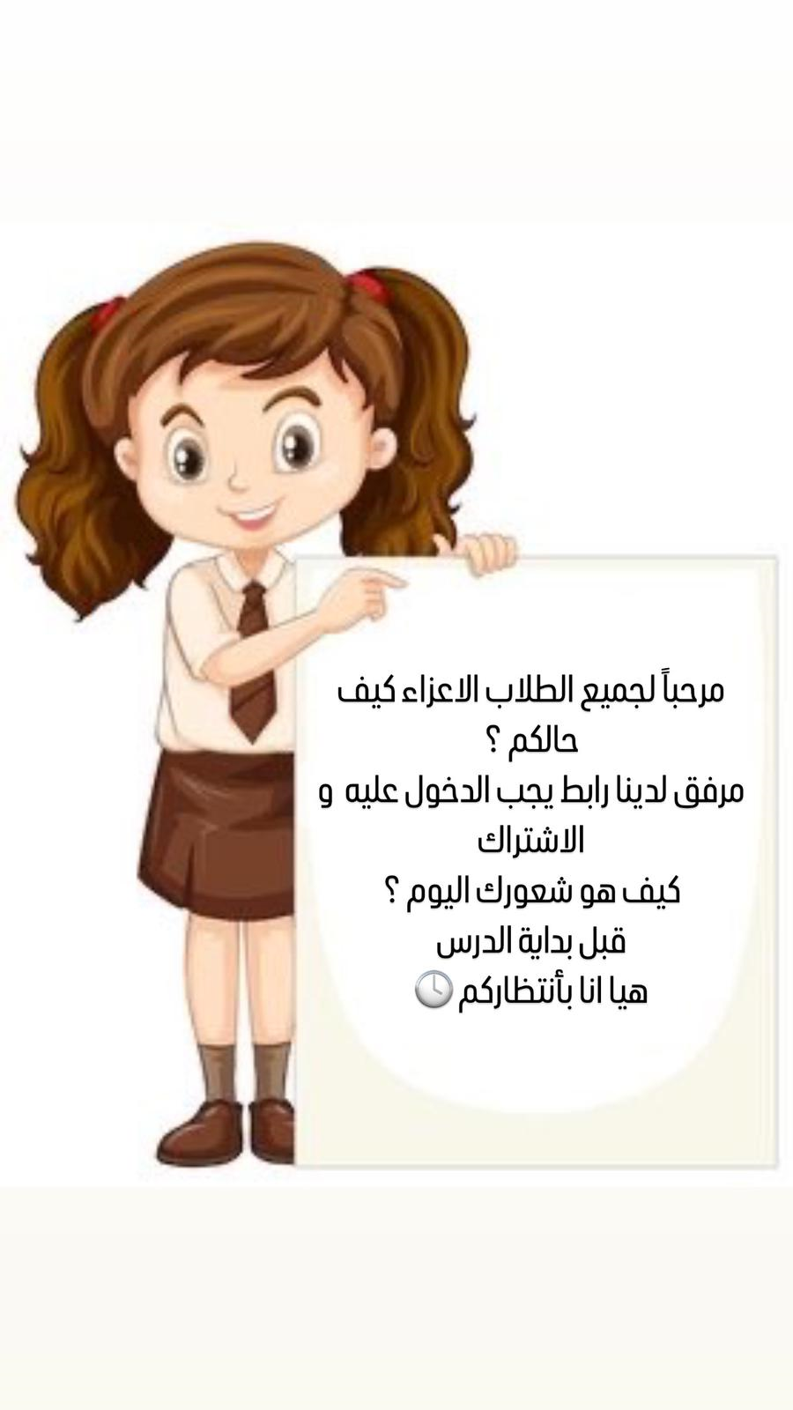
الرابط :
https://docs.google.com/forms/d/e/1FAIpQLSe0w-R6plBTLErU66ohpLi-Mtow5Vr8d5sw6XNSx4G2s7OumA/viewform?usp=sf_link

